Slide 1
SDM® 3.0 Risk Assessment Validation and Practice-Driven Changes

Slide 2
Connecting Safety and Risk
Safety Assessment
Informs what we are worried about
Risk Assessment
Informs how worried we should be
Notes:
These two SDM assessments work together to help us make critical decisions about how to intervene.
The SDM safety assessment informs what we are worried about and helps us to know what immediate actions need to be taken to create safety.
The SDM risk assessment informs how worried we should be about this family and helps us know whether the family may benefit from continued involvement.

Slide 3


The Difference Between Risk and Safety Threat
RISK
SAFETY THREAT
Notes:
Here is another way to think about the difference between risk and safety threat:
High (or very high) risk applies to situations in which the chance of an adverse event happening is unusually high, such as a place along the road where a deer crossing sign is posted. The sign does not mean you need to slam on your breaks—it just means to be extra cautious.
Danger means a deer is on the road! An accident has just happened, is happening, or is about to happen unless someone changes course immediately.

Slide 4
Risk Assessment: How worried should we be?
What is the likelihood of future abuse or neglect?
LOW
close
MODERATE
HIGH
VERY HIGH
open
Notes:
The risk assessment estimates the likelihood that maltreatment of any severity will occur in this family in the future. This information is used to guide two key decisions: whether or not to open an ongoing services case after the investigation and, if so, the service intensity to provide.
Because it is research-based, the risk assessment tool does not require a comprehensive list of every conceivable variable. Instead, it is limited to a set of items that have a demonstrated relationship with actual case outcomes. The medical profession is an example of another application for this type of tool. For example, breast cancer researchers have identified a set of three variables that are most important to risk among patients with an identified breast tumor. Knowing these three items provides all the vital knowledge a doctor needs to discuss the most appropriate treatment options based on the risk of the specific tumor.
Likewise, in CPS we can know thousands of pieces of information about a family. However, to estimate the likelihood of future maltreatment, we can limit the list to items with demonstrated relationships to actual outcomes. The tool also focuses on items that are likely available to a worker at the conclusion of an investigation. There is more information available than we had at the first face-to-face contact, but less than we will know six months after case opening. Finally, the tool incorporates as many concrete and easily observable items as possible (about half of the items). This increases the reliability of the assessment.

Slide 5
2013 California Risk Validation Results
N = 11,444 substantiated/inconclusive investigations from July 1, 2010 – June 30, 2011; 18-month follow-up period
Notes:
The original California risk study was done in 1998, and the resulting tool was used from 1999 to 2005. Typically, CRC conducts a revalidation about every five years. California has completed four validations of the risk assessment. Here are the most recent validation results, from 2013. This is important in learning whether slight adjustments are required.
DIGGING DEEPER: Revalidation studies also take advantage of increasingly systematic record-keeping. Some important items may not work in early tools solely because case records did not systematically report those items. Also, revalidation studies are generally prospective, so they reflect use of the tool in the field rather than case record reviews.
The most recent California risk revalidation study was conducted in 2013, and the current tool is the result of this study. You can see that the tool is very robust. The slide shows results for re-referrals, re-substantiations, and placements. You can see that for each outcome, as risk level goes up, the chances that a family will have that outcome increases significantly.
For example, the chances that a low-risk family will not have a new investigation over the next two years is about 84% (rate = 16%). Chances that they will not have a new substantiation are 95% (rate = 5%), and it appears that even if there is a substantiation, it is extremely unlikely to be a serious situation as only about 1% of low-risk families have a child end up in foster care within 18 months.
In contrast, a very high-risk family has about a 58% chance of HAVING at least one new investigation. Many of these families, in fact, will have multiple referrals in the next 18 months. Almost one quarter of them will be substantiated at least once more, and 16% will result in a foster placement.
If you had the resources to serve all families, you would not need to choose. But if you have only enough workers to serve either a low-risk family or a high-risk family, and your goal is to prevent future harm, which family would you select? Why?
TRAINER NOTE: Desired response is to serve the very high-risk family because services may prevent future harm. For low-risk families, there is little to prevent, although referrals to community support services for identified needs should be made.
DIGGING DEEPER: For background, you may wish to become familiar with the risk study. You can download a copy at docs.sdmdata.org. The user name is “california” and the password is “training.” Select Trainer Resources and select Risk Revalidation Report 2013. A new validation study was completed in 2013, and an updated risk assessment will be introduced in November 2015.

Slide 6
The SDM risk assessment has four main sections:
Neglect and Abuse Indices
Scored Risk Level
Overrides
Final Risk Level
Notes:
The risk assessment has four sections: the neglect index and abuse index, the scored risk level, overrides, and the final risk level decision. Note that the risk assessment is presented in single-stream format, which reduces redundancy and allows workers to better structure interviews and information gathering.
To complete the assessment, the social worker answers all of the questions on the neglect and abuse indices, at the same time, using the definitions. The risk factors in the indices were developed based on research. Items on the assessment are weighted differently based on their statistical relationship to the likelihood of future abuse and/or neglect. Then, the numerical score for each index is added up. This results in a neglect score and an abuse score. The scored risk level for this family is the higher of the two levels.
Before the assessment is finalized, the social worker considers policy and discretionary overrides to change the risk level, which will be discussed in further detail during the onsite training.
At the end of the assessment, the final risk level is used to determine whether families should receive ongoing protective intervention services. Families classified as low or moderate risk are recommended for file closure, and high- and very high-risk families are recommended for ongoing protective intervention services.
There are two indices, neglect and abuse, scored in a single stream.
DIGGING DEEPER: Ask for ideas about why both indices are necessary (i.e., risk assessment examines the probability of FUTURE harm, and it’s not uncommon for there to be multiple types of maltreatment in a family).
TRAINER NOTE: Walk through each item, pointing out that many of these items are very concrete and easily observable. This contributes to reliability.
In scoring each item, include anything that would have been present on the date of the reported incident or has become present since then. Think of a risk factor like an “on” switch: once it is turned on, it stays on for the purpose of this initial risk assessment.
DIGGING DEEPER: Ask for ideas as to why this may be. We don’t know for certain, but we do KNOW that research documents this distinction.
COMPUTER NOTE: On the computer, the worker will only need to check the item. The score is automatically calculated and totaled.
(Point to the scored risk level.) The worker checks the appropriate risk level for each index: the scored risk level is the higher index. This information tells us that this family looks like other families with known rates of subsequent maltreatment ranging from low to very high.
Look at the policy overrides. These are conditions that may be so rare that they do not show up statistically or were not documented in the reviewed case files, yet the core team agrees that in these situations, it is appropriate to respond as if the family is very high risk.
Look at the discretionary overrides. The SDM system does not replace clinical judgment. The worker has the right—in fact, the responsibility—to examine this family in light of the risk tool and ask whether unique conditions not captured by the tool warrant an increase in risk level. At the time of reassessment, a worker may override the risk level up one level. Supervisor approval is required.
TRAINER NOTE: Ask for ideas about why, at this time, risk can only be increased (i.e., do not know family very well at this point . . . best to err on side of caution).
DIGGING DEEPER: An example of an override might be a single parent of a six-month-old child who has no mental health or substance use and no prior history and few other risk factors. The total risk score is likely to be moderate. However, in the past three months, her mother died, her husband left, she lost her job and moved across the country, knows no one in town, is running out of money, and the baby has colic. The allegation was physical abuse, and you learned during the investigation that she does not believe in corporal punishment, but she lost her temper and spanked the baby. However, it was on the buttock with an open hand and did not leave injury. You may override up one level to high, with a reason such as “Mother is under extraordinary stress, which increases her risk. The child is very young, so the absence of CPS history may be an indicator of lower risk, or it may be related to absence of opportunity to acquire a CPS history.”
COMPUTER NOTE: In WebSDM, when you finish an SDM assessment, it will be sent to your supervisor for approval.

Slide 7
Initial Risk Assessment – Structural Changes
Major Changes
Single-stream format – one list of items, not two
Maintains separate abuse and neglect items and levels
Highest on either neglect still determines overall risk
Why
Allows answering common questions one time rather than two
Reduction in common errors (prior investigations, prior open cases)
Reduction in discrete number of items
Allows grouping of items by content area to enable more structured interviews:
Prior investigations details,
Current investigation details
Family characteristics
Item Language and Definitions
Switch from “score” this item to “identify and choose”
Neutral language in most items

Slide 8
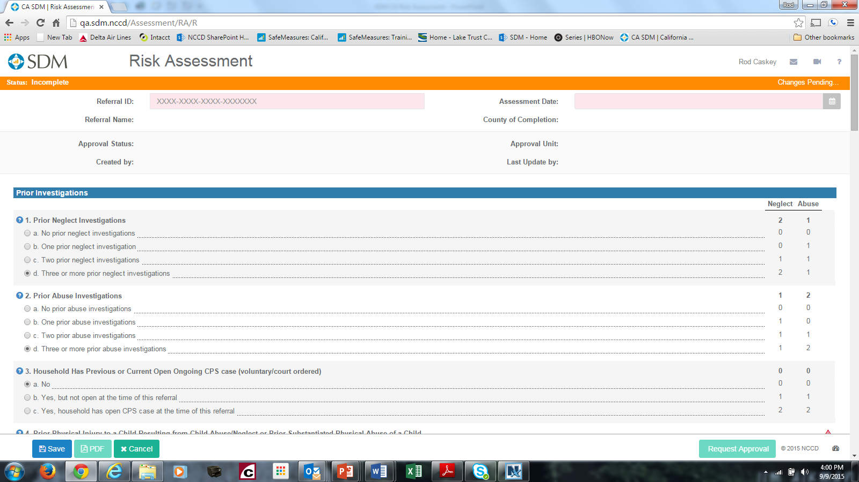

Slide 9
Initial Risk Assessment – Item Changes
Major Changes to Abuse (A) and/or Neglect (N)
Validation-driven changes: Many items are now for both primary and secondary caregivers
Mental health (A and N)
History of abuse or neglect (A and N)
Criminal History (N)
Items added
Primary caregiver assessment of incident (A)
Primary/secondary alcohol or drug use (A and N)
Primary caregiver blames child (A)
New supplemental items
Items Removed
Physical care of child (N)
Primary caregiver domineering
(A)
Delinquency history from child characteristics (A)
Reduced weight
Prior investigations (A)
Child characteristics (N)
Separated prior open case into
Open in the past but closed
Open case at time of this referral

